Slide 1

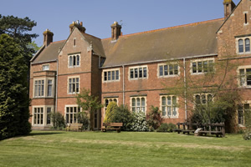
Innovations in ICT, 2012
Martyn Race
Lord Williams’s School
Thame, Oxfordshire

Slide 2

Action Plan
Word Wall:
Trial with KS3 classes.
A-level Physics website:
Develop before end-May, before starting on KS3/4 for next year
Using a webcam:
Showing marked work and demos
http://www.tinorace.co.uk/docs/ICT2012/Action%20Plan%20NEW.doc

Slide 3
· Did your action plan achieve what you hoped it would? (consider the timings and actions)If it did, why was it successful? If it didn’t, why not? · What have you learnt about your own practice from implementing your action plan?· What would you change if you were going to do it again?· What evidence do you have of the level of impact of your action plan (see ‘How We Assess the Level of Impact’)?
Examples of evidence to collect could include: · Digital photographs.· Pupils/students’ written work.· Taped or transcribed interviews with pupils/students and/or staff.· Video/DVD clips (if you need a VCR/DVD player please let me know).· Questionnaires.· Assessment data before and after the gap task.

Slide 4


Slide 5
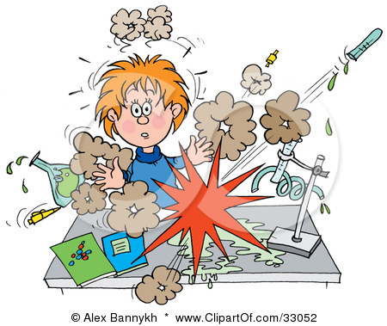
WordWall - activities
Class: Year 7
Class size: 27 students
Lesson: e.g. Cells and Organs revision (focus on keywords)
What I did:
The first time I used WordWall. I created a keyword matching exercise. After the words were guessed I shuffled them and played again with new people. Then again...

Slide 6


Evaluation
Every student in the class participated
Every student eventually succeeded (even if they didn’t know any of the key words before the activity
Very easy to run the activity
Things to consider:
Can only use evaluation copy in 1 lab per day
Would others find the interface easy to use?
Takes time to develop activities

Slide 7
WordWall – seating plans
Class: Year 7
Class size: 29 / 28 students
What I did:
I used Word Wall to create seating plans for my Year 7 classes. I have also used it to randomly select students to answer questions.

Slide 8
Feedback from TA
Evidence: A bigger range of students were answering questions than before with hand up (or even by me choosing)
Some annoying niggles with the software
No obvious help/instructions
Not going to be for everyone

Slide 9

Evaluation
Ran out of time on this one
Reduced emphasis on this part of action plan to focus on other two parts.
Enjoyed using the software
See massive potential
Would require the whole school to buy into it really
For the future: When there is time I will show this software at a faculty meeting and get at least 2 other people to create an activity and use it in a lesson

Slide 10
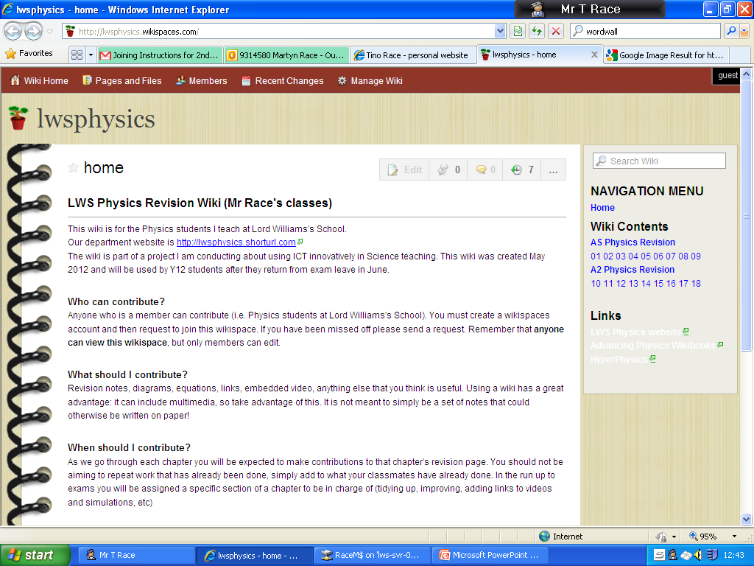
LWS Physics
Website and Wiki

Slide 11
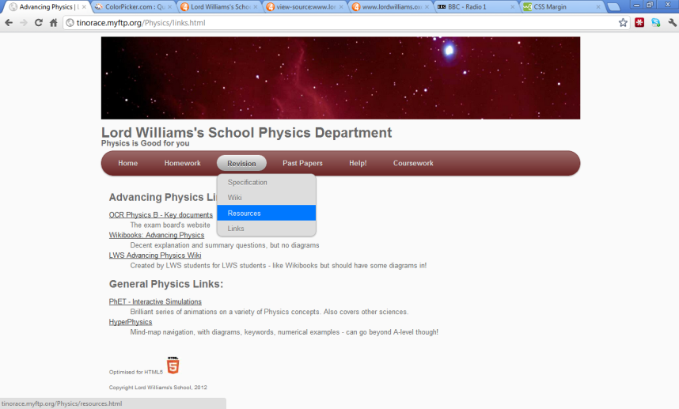
Physics Website and Wiki
Class: Year 12/13
Class size: 8 / 12 students
Lesson: Yet to be used in lessons ☹
What I did:
Wrote the code for a website from scratch.
Uploaded relevant documents
Put up course help and revision resources
Questionnaire with Y12 students before making it

Slide 12


Slide 13
Feedback from Y12 students
Y12 students broadly agreed with what should be on the Physics website. They said that the most useful thing would be being able to download all past papers from one place. While they didn’t mention coursework I think this is a big priority for the department, so I included lots of help for this on the site.

Slide 14
Evaluation and evidence
None as yet (from students)
Next year I hope to see an improvement in coursework quality due to use of resources on site
I have improved my personal ability to code HTML5 and manage a website
I am personally very pleased with the website
For the future: Ask students for feedback on the site next year and make improvements based on this

Slide 15
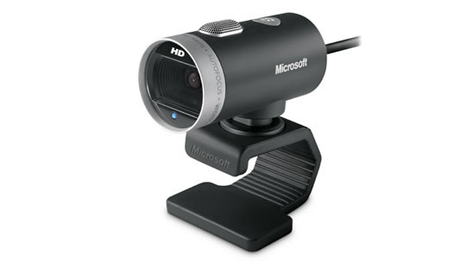
WEBCAM

Slide 16
Webcam for feedback
Class: Year 13
Class size: 12 students
Lesson: Physics revision (focus on explain questions)
Task:
Students answered 3 explain questions. At the end I chose 3 people (low, middle, high ability each time) to show their answers, highlight where they thought their marks were achieved, and the rest of the class voted on how many marks it should get. Then I projected the mark scheme

Slide 17
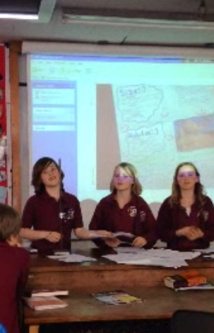
Webcam in action
While I was just trialling it I used my own webcam in a clamp stand!
The image was displayed on the screen via ‘My computer’. Would be nice to have a full screen option

Slide 18
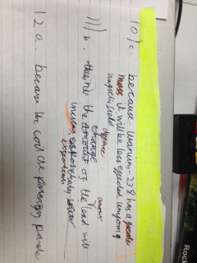

Students were asked to highlight where they thought they achieved marks

Slide 19
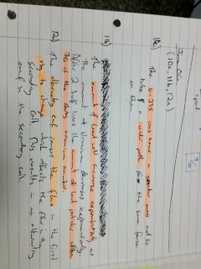
Extra highlighting was added by the teacher as the rest of the class argued for extra marks in the answers
Then students voted for how many marks to award to each answer and finally compared to the mark scheme

Slide 20
Feedback from Y13 students
“Interactive, everyone was involved”
“Good to see other students’ answers”
“Good to see how to get marks concisely”
“Good to see answers as its easy to forget what’s been read out”
“Would be useful for diagrams but answers could be read out just as easily”
“Good but a bit slow”
“Highlighting key words was very useful”
“Could be embarrassing for bad spellers”
Evidence: Students were asked to evaluate what they had just done on paper and hand in to me.
First time I had done this sort of activity!

Slide 21
Evidence of impact
General positive feedback from students
Students were able to improve their answers immediately
Students were discussing/comparing work with a range of other students (normally they’d just talk to person next to them)
Next time: If I had more time before exams/RP2 I would set similar questions again to check for improvement

Slide 22
Webcam for feedback
Class: Year 7
Class size: 29 students
Lesson: Returning marked adaptations projects
Task:
Students received their marked adaptations projects. I asked groups of students to choose the best project in their group, then show it under the webcam and explain why they thought it was the best one.

Slide 23

Students peer assessing
Example of students peer assessing homework #1
Example of students peer assessing homework #2

Slide 24
Feedback from Y7 students
I took a vote: Do you agree that this sort of activity will help you improve your work in future homework?
Yes: 9 No: 10 Unsure: 3
Student interview (agreed) 1
Student interview (agreed) 2
Student interview (disagreed) 1

Slide 25
Evaluation and evidence
Sixth Form students very positive (written feedback)
KS3 students unsure (interviews and vote)
I personally feel a lot more confident leading feedback sessions which will result in improved work
Another teacher tested (for a demo) and found it useful
For the future: I will definitely continue to use a webcam for feedback and demos. I will need to show this in a meeting and encourage other teachers to use this

Slide 26
The future of education…?
https://6002x.mitx.mit.edu/

Slide 27
Links related to my project
Website/Blog:
http://ww.tinorace.co.uk
Physics Wiki:
http://lwsphysics.wikispaces.com/
Website:
http://lwsphysics.shorturl.com/
Twitter:
https://twitter.com/#!/tinorace
This project was done as part of the Innovations in ICT course run by the National Science Learning Centre
Course wiki: http://ictinnovations2012.wikispaces.com/
Course Leader: John Walker

